Slide 1
TASK # 2 OPTIMIZATION PROBLEMS. TRANSPORTATION PROBLEM – APPLICATION IN WATER RESOURCES MANAGEMENT
ALEKSANDAR KOMAtINA

Slide 2
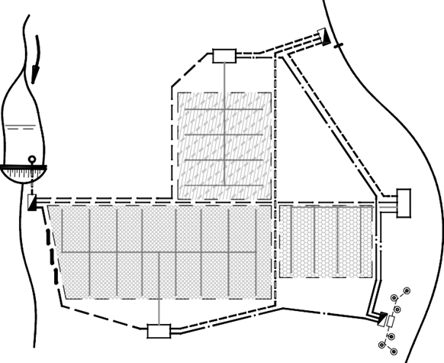
The daily supply capacities of water sources A_{i} and the demands for the water users B_{j}
Water Source | Supply Capacity 10³.m³ | Water User | Demand, 10³.m³
А1 (PS 1) | 80 | В1 (RR 1) | 65
А2 (PS 2) | 55 | В2 (RR 2) | 75
А3 (PS 3) | 50 | В3 (RR 3) | 65

Slide 3
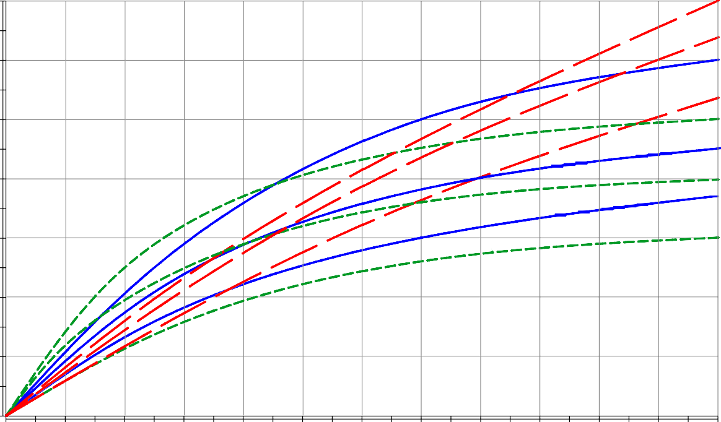
The costs Z_{i,j} for supplying water from water source A_{i} to water user B_{j} are variable, according to the supplied volumes V_{i,j}. Cost functions Z_{i,j} – V_{i,j}

Slide 4
The type of transportation problem is determined by checking if the total supply is equal to the total demand:
The disbalance is: 185- 205= -20 m³.10³. (i.e. deficit is 20 m³.10³.).
A virtual water source A₄

Slide 5
COST READ FROM THEGRAPH
 | Volumes of water
Cost | 0 | 20 | 40 | 70 | 100
Z1,1 | 0 | 1,3 | 2,2 | 3 | 3,5
Z1,2 | 0 | 1,75 | 2,9 | 3,8 | 4,3
Z1,3 | 0 | 2 | 3,6 | 5 | 5,7
Z2,1 | 0 | 2,5 | 3,7 | 4,5 | 4,9
Z2,2 | 0 | 1,1 | 2 | 2,6 | 2,9
Z2,3 | 0 | 2 | 2,9 | 3,6 | 3,9
Z3,1 | 0 | 1,5 | 2,7 | 4,3 | 5,6
Z3,2 | 0 | 1,6 | 3 | 4,7 | 6,1
Z3,3 | 0 | 1,2 | 2,3 | 3,7 | 4,7
Z4,1
Z4,2
Z4,3

Slide 6
 | Polynomial: Z = aV + bV2 + cV3 + dV4
Cost | a | b | c
z 1,1 | 0.077386 | -0.000653 | 0.000002
z 1,2 | 0.106582 | -0.001003 | 0.000004
z 1,3 | 0.11657471 | -0.00074167 | 0.00000147
z 2,1 | 0.156667 | -0.001912 | 0.000008
z 2,2 | 0.06835301 | -0.00054407 | 0.00000151
z 2,3 | 0.122596 | -0.001472 | 0.000006
z 3,1 | 0.07965683 | -0.00032797 | 0.00000091
z 3,2 | 0.086965 | -0.000333 | 0.000001
z 3,3 | 0.06288 | -0.000083 | -0.000001
z 4,1 | 1 | 0 | 0
z 4,2 | 1 | 0 | 0
z 4,3 | 1 | 0 | 0

Slide 7
 | Costs read from the graph |  |  |  |  | Costs calculated by trend line functions
 | Volumes of Water |  |  |  |  | Volumes of Water
Cost | 0 | 20 | 40 | 70 | 100 | 0 | 20 | 40 | 70 | 100
z 1,1 | 0 | 1,3 | 2,2 | 3 | 3,5 | 0 | 1.303 | 2.179 | 2.903 | 3.209
z 1,2 | 0 | 1,75 | 2,9 | 3,8 | 4,3 | 0 | 1.762 | 2.914 | 3.918 | 4.628
z 1,3 | 0 | 2 | 3,6 | 5 | 5,7 | 0 | 2.047 | 3.570 | 5.030 | 5.711
z 2,1 | 0 | 2,5 | 3,7 | 4,5 | 4,9 | 0 | 2.433 | 3.719 | 4.342 | 4.547
z 2,2 | 0 | 1,1 | 2 | 2,6 | 2,9 | 0 | 1.162 | 1.960 | 2.637 | 2.905
z 2,3 | 0 | 2 | 2,9 | 3,6 | 3,9 | 0 | 1.911 | 2.933 | 3.427 | 3.540
z 3,1 | 0 | 1,5 | 2,7 | 4,3 | 5,6 | 0 | 1.469 | 2.720 | 4.281 | 5.596
z 3,2 | 0 | 1,6 | 3 | 4,7 | 6,1 | 0 | 1.614 | 3.010 | 4.799 | 6.367
z 3,3 | 0 | 1,2 | 2,3 | 3,7 | 4,7 | 0 | 1.216 | 2.318 | 3.652 | 4.458
z 4,1 | 0 |  |  |  |  | 0 | 20.000 | 40.000 | 70.000 | 100.000
z 4,2 | 0 |  |  |  |  | 0 | 20.000 | 40.000 | 70.000 | 100.000
z 4,3 | 0 |  |  |  |  | 0 | 20.000 | 40.000 | 70.000 | 100.000
Z = aV + bV² + cV³ + dV⁴

Slide 8
Matrix of volumes
 | B1 | B2 | B3 | Sum | Available V
A1 | 65 | 15 | 0 | 80 | 80
A2 | 0 | 55 | 0 | 55 | 55
A3 | 0 | 5 | 45 | 50 | 50
A4 | 0 | 0 | 20 | 20 | 20
Sum | 65 | 75 | 65 | 0 | 205
Needed V | 65 | 75 | 65 | 205
Matrix of costs
 | B1 | B2 | B3 | Sum
A1 | 2.82042 | 1.94681 | 0.00000 | 4.76722
A2 | 0.00000 | 2.36483 | 0.00000 | 2.36
A3 | 0.00000 | 0.57693 | 2.57040 | 3.15
A4 | 0.00000 | 0.00000 | 20.00000 | 20.00
 |  |  |  | 30.27938
Sum | 2.82042 | 4.88857 | 22.57040 | 30.279 | Check
All Constrains and optimality conditions are satisfied.

